Slide 1

P9 – Chair: Isa Steinmann Early Education
EARLI SIGs 18 & 23 Joint conference
Closing the Gaps? Differential Accountability and Effectiveness as a Road to School Improvement

Slide 2
Early Education
Presentations 15 minutes | Discussions 5-7 minutes
The effect of preschool on later reading literacy: Results for Germany using propensity score matching Isa Steinmann, Nina Hogrebe, Rolf Strietholt, Laura Zieger
Long-term effects of primary schools on mathematics achievement and non-cognitive outcomes of students at age 17 Griet Vanwynsberghe, Gudrun Vanlaar, Bieke De Fraine, Jan Van Damme
Marginal structural models of the effects of early grade retention on math achievement Machteld Vandecandelaere, Stijn Vansteelandt, Bieke De Fraine, Jan Van Damme
Combatting disadvantage in the early years: Evaluating the impact of Children’s Centres in promoting better outcomes for children, parents and families in England Pamela Sammons, James Hall, Rebecca Smees, Kathy Sylva

Slide 3
The effect of preschool on later reading literacy: Results for Germany using propensity score matching OSLO, September 29, 2016
Isa Steinmann, Nina Hogrebe, Rolf Strietholt, & Laura Zieger
isa.steinmann@tu-dortmund.de
Institute for School Development Research
Dortmund University of Technology

Slide 4
Structure
Introduction: Preschool Effects
Methods: Propensity Score Matching and Causal Inference
Results: Balance Checks and Causal Effects
Conclusion and Outreach
References
Appendixes

Slide 5

1. Introduction: Preschool Aims
Since 1996, three-year-old children in Germany are entitled to attend preschool
Main aims of expanding preschool (cf. Hogrebe, 2014):
Compatibility of family and career
Improvement of preparation for school
Families and preschools are the most
important learning environments for
young children
Preschool is expected to foster later
achievement (e.g. Knudsen et al., 2006)
proximal
distal
(cf. Bronfenbrenner, 1990)
Notes:
Ecological theory of human development

Slide 6
1. Introduction: Preschool Attendance
Nowadays, 94.9% do attend preschools (DESTATIS, 2015)
Selection/decision processes described as interplay of individual, context, and time factors (Process-Person-Context-Time model; Bronfenbrenner & Morris, 2006)
Preschool non-attendance is associated
with low parental education, low income,
and migration background (cf. Early &
Burchinal, 2001; Grogan, 2012;
Kim & Fram, 2009)
proximal
distal
(cf. Bronfenbrenner, 1990)
Notes:
Child care decisions (process) are influenced by preferences (person) and circumstances of life (context)

Slide 7
1. Introduction: Preschool Effects
PIRLS 2011: Positive relationship between preschool participation and reading abilities in fourth grade (Mullis et al., 2012)
→ Correlative results from cross-sectional studies should – due to selection bias – be interpreted with caution
Meta-analyses and reviews show substantial but rather mixed effects due to program types and target groups (Barnett, 2011; Burger, 2010; Camilli et al., 2010; Chambers et al., 2010; Duncan & Magnuson, 2013; Pianta et al., 2009)
Experimental studies: High/Scope Perry Preschool Project (Schweinhart et al., 2005) or Abecedarian Program (Campbell & Ramey, 1995)
Ca. 100 children with disadvantaged backgrounds
High intensity and quality of programs
Beneficial long-term effects on several outcomes in school age
→ Generalizability?

Slide 8
1. Introduction: Preschool Effects
More recent international studies could not (fully) replicate these promising findings (cf. Barnett, 2011)
Head Start study: No significant effects on later achievement (Puma et al., 2012)
Early Head Start study: Only reading ability effects for low risk students (Vogel et al., 2010)
Effective Provision of Preschool Education project: effects for high risk students (Sylva et al., 2008)
Effects for disadvantaged students in two out of nine countries (Hogrebe & Strietholt, 2016)
Basically no robust findings in Germany (Anders & Roßbach, 2014)
What is the average achievement of children who did not attend preschool compared to what it would have been if they had attended preschool?

Slide 9
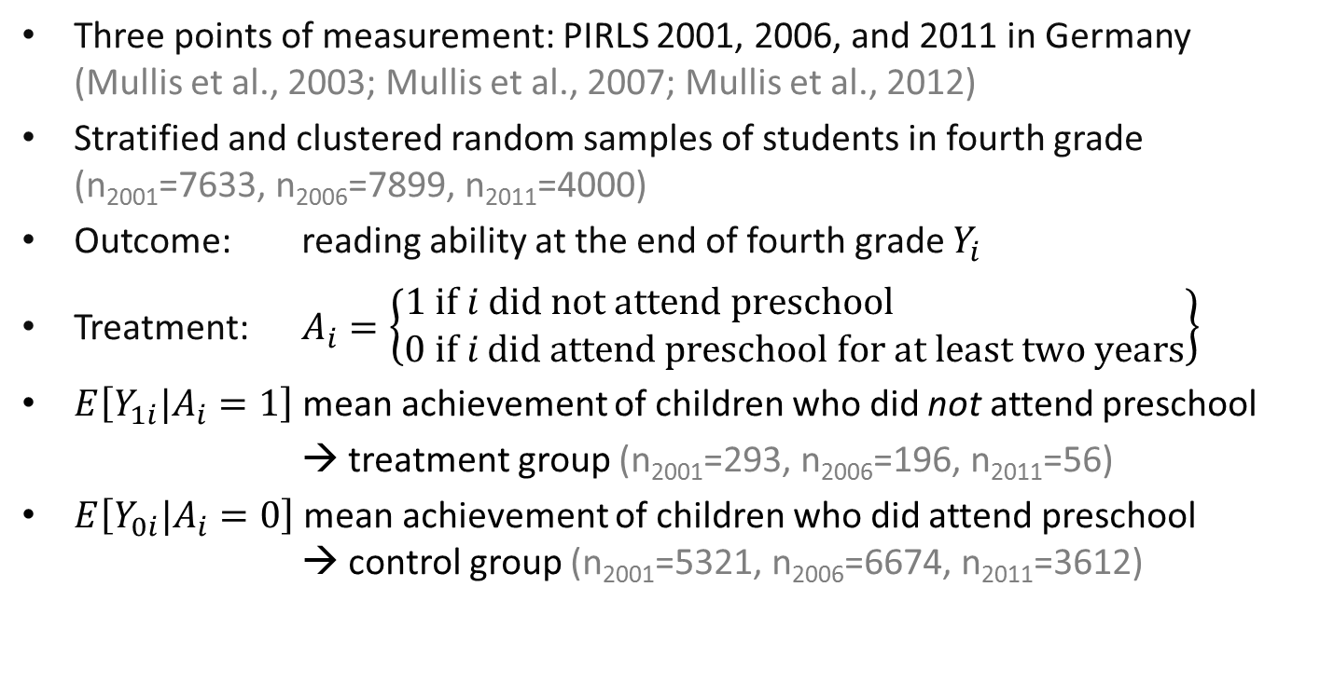
2. Methods: Sample & Variables
Three points of measurement: PIRLS 2001, 2006, and 2011 in Germany (Mullis et al., 2003; Mullis et al., 2007; Mullis et al., 2012)
Stratified and clustered random samples of students in fourth grade (n₂₀₀₁=7633, n₂₀₀₆=7899, n₂₀₁₁=4000)
Outcome: reading ability at the end of fourth grade $Y_{i}$
Treatment: $A_{i}=\left\{\begin{aligned}1 \text{if} i \text{did} \text{not} \text{attend} \text{preschool} \\ 0 \text{if} i \text{did} \text{attend} \text{preschool} \text{for} \text{at} \text{least} \text{two} \text{years}\end{aligned}\right\}$
$E\left[Y_{1i}|A_{i}=1\right]$ mean achievement of children who did not attend preschool
→ treatment group (n₂₀₀₁=293, n₂₀₀₆=196, n₂₀₁₁=56)
$E\left[Y_{0i}|A_{i}=0\right]$ mean achievement of children who did attend preschool → control group (n₂₀₀₁=5321, n₂₀₀₆=6674, n₂₀₁₁=3612)

Slide 10

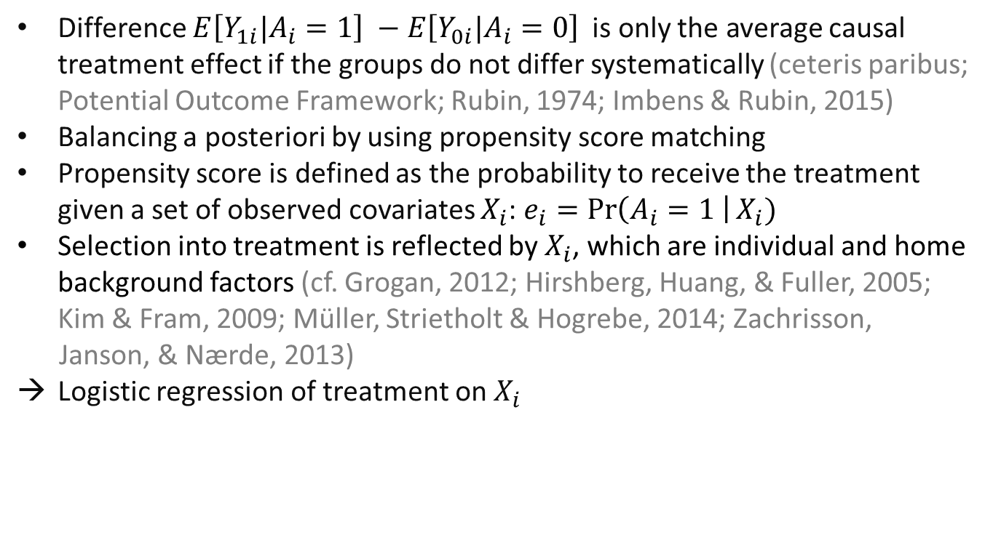
2. Methods: Propensity Score Matching
Difference $E\left[Y_{1i}|A_{i}=1\right] −E\left[Y_{0i}|A_{i}=0\right]$ is only the average causal treatment effect if the groups do not differ systematically (ceteris paribus; Potential Outcome Framework; Rubin, 1974; Imbens & Rubin, 2015)
Balancing a posteriori by using propensity score matching
Propensity score is defined as the probability to receive the treatment given a set of observed covariates $X_{i}$: $e_{i}=\operatorname{Pr}\left(A_{i}=1 \right|X_{i})$
Selection into treatment is reflected by $X_{i}$, which are individual and home background factors (cf. Grogan, 2012; Hirshberg, Huang, & Fuller, 2005; Kim & Fram, 2009; Müller, Strietholt & Hogrebe, 2014; Zachrisson,
Janson, & Nærde, 2013)
Logistic regression of treatment on $X_{i}$

Slide 11

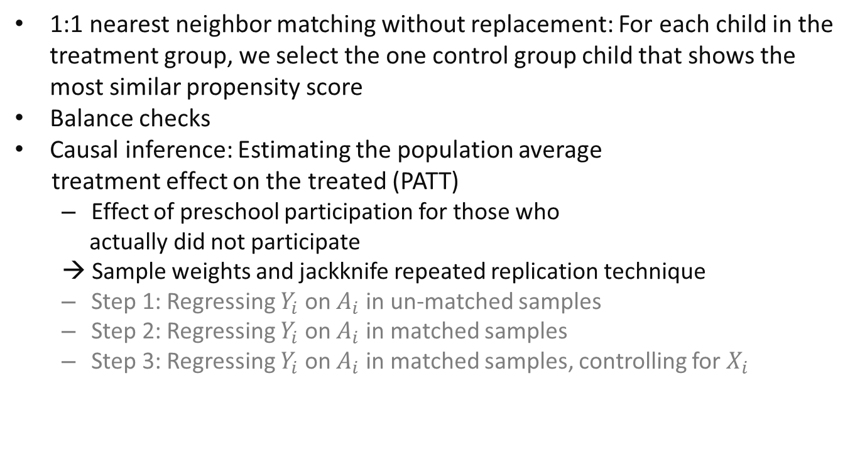
2. Methods: Propensity Score Matching and Causal Inference
1:1 nearest neighbor matching without replacement: For each child in the treatment group, we select the one control group child that shows the most similar propensity score
Balance checks
Causal inference: Estimating the population average
treatment effect on the treated (PATT)
Effect of preschool participation for those who
actually did not participate
→ Sample weights and jackknife repeated replication technique
Step 1: Regressing $Y_{i}$ on $A_{i}$ in un-matched samples
Step 2: Regressing $Y_{i}$ on $A_{i}$ in matched samples
Step 3: Regressing $Y_{i}$ on $A_{i}$ in matched samples, controlling for $X_{i}$

Slide 12
3. Results: Balance Check Results
2001
2006
2011
Propensity Score
Gender
Language at home
Books at home (parents)
Books at home (students)
Parents attitudes towards reading
Highest occupational status
Highest parental education
Early home literacy activities
-0.5
0.0
0.5
-0.5
0.0
0.5
-0.5
0.0
0.5
Note. ● indicates the standardized mean difference between control and treatment groups before matching and × after matching
(broken lines -0.25/+0.25).
Standardized bias indicates good balance (always between -0.25 and 0.25)
Ratio of variances of propensity scores always between 0.86 and 1.01
Ratio of variances of the residuals of the covariates after propensity score regression between 0.73 and 1.18

Slide 13
3. Results: Causal Effects
 | 2001 | 2006 | 2011
Un-matched Sample
Constant | 544.91** (1.89) | 550.32** (2.15) | 543.23** (2.33)
Treatment | -28.67** (8.17) | -28.73* (13.28) | -40.34** (10.34)
Covariates | no | no | no
N | 5614 | 6967 | 3668
Matched Sample
Constant | 525.14** (8.94) | 531.52** (11.98) | 516.46** (10.11)
Treatment | -8.90 (8.79) | -9.93 (15.21) | -13.57 (14.63)
Covariates | no | no | no
N | 587 | 392 | 112
Matched Sample with Controls
Constant | 392.73** (18.94) | 445.71** (37.07) | 433.34** (45.69)
Treatment | -9.96 (8.23) | -12.51 (13.22) | -11.73 (11.38)
Covariates | yes | yes | yes
N | 587 | 392 | 112
Note. * = p < 0.05, ** = < 0.01.

Slide 14
3. Results: Causal Effects
 | 2001 | 2006 | 2011
Un-matched Sample
Constant | 544.91** (1.89) | 550.32** (2.15) | 543.23** (2.33)
Treatment | -28.67** (8.17) | -28.73* (13.28) | -40.34** (10.34)
Covariates | no | no | no
N | 5614 | 6967 | 3668
Matched Sample
Constant | 525.14** (8.94) | 531.52** (11.98) | 516.46** (10.11)
Treatment | -8.90 (8.79) | -9.93 (15.21) | -13.57 (14.63)
Covariates | no | no | no
N | 587 | 392 | 112
Matched Sample with Controls
Constant | 392.73** (18.94) | 445.71** (37.07) | 433.34** (45.69)
Treatment | -9.96 (8.23) | -12.51 (13.22) | -11.73 (11.38)
Covariates | yes | yes | yes
N | 587 | 392 | 112
Note. * = p < 0.05, ** = < 0.01.

Slide 15
3. Results: Causal Effects
 | 2001 | 2006 | 2011
Un-matched Sample
Constant | 544.91** (1.89) | 550.32** (2.15) | 543.23** (2.33)
Treatment | -28.67** (8.17) | -28.73* (13.28) | -40.34** (10.34)
Covariates | no | no | no
N | 5614 | 6967 | 3668
Matched Sample
Constant | 525.14** (8.94) | 531.52** (11.98) | 516.46** (10.11)
Treatment | -8.90 (8.79) | -9.93 (15.21) | -13.57 (14.63)
Covariates | no | no | no
N | 587 | 392 | 112
Matched Sample with Controls
Constant | 392.73** (18.94) | 445.71** (37.07) | 433.34** (45.69)
Treatment | -9.96 (8.23) | -12.51 (13.22) | -11.73 (11.38)
Covariates | yes | yes | yes
N | 587 | 392 | 112
Note. * = p < 0.05, ** = < 0.01.

Slide 16
4. Summary of Results and Conclusion
Before matching
Children who did not attend preschool have disadvantaged backgrounds
Children who did attend preschool for at least two years show significantly better reading abilities in all three cycles
After matching
Reading disadvantages of children who did not attend preschool are not significant on a 5%-level
Results do not change substantially after including covariates as controls to account for remaining imbalances
No empirical evidence for the hypothesis that attending preschool would result in reading benefits for children who did not participate
Former studies showed beneficial effects for certain countries or high quality programs
Preschool in Germany seems not to tap its full potential (cf. Duncan & Magnuson, 2013)
Notes:
Control group may have changed (selbst Kinder aus benachteiligten Familien werden heutzutage förderlich beschäftigt…)

Slide 17
4. Limitations and Outreach
Ignorable treatment assignment assumption: no hidden bias from unobserved covariates (Rosenbaum & Rubin, 1983)
Complete set of covariates?
If students who did not participate are even more disadvantaged than observed, we would overestimate the group differences which are now already non-significant
But: no randomized controlled trial
Generalizability
Disadvantaged students
Reading in fourth grade
In no cycle, we found support for the hypothesis that preschool is a beneficial treatment for reading abilities of disadvantaged students

Slide 18
!
Thank you very much for your attention

Slide 19
5. References I
Anders, Y. & Roßbach, H.-G. (2014). Empirische Bildungsforschung zu Auswirkungen frühkindlicher, institutioneller Bildung: Internationale und nationale Ergebnisse. In Braches-Chyrek, R., Rühner, Ch., Sünker, H., & Hopf, M. (eds.), Handbuch frühe Kindheit (pp. 335–347). Opladen: Barbara Budrick.
Barnett, W. S. (2011). Effectiveness of early education interventions. Science, 333(6045), 975–978. doi:10.1126/ science.1204534.
Bronfenbrenner, U. (1990). The ecology of cognitive development. Zeitschrift für Sozialisationsforschung und Erziehungssoziologie, 10(2), 101–114.
Bronfenbrenner, U., & Morris, P. A. (2006). The bioecological model of human development. In W. Damon & R. M. Lerner (Eds.), Handbook of child psychology ((Series Ed.) 6 ed., Vol. 1, pp. 793–828). New York, NY: Wiley.
Burger, K. (2010). How does early childhood care and education affect cognitive development? An international review of the effects of early interventions for children from different social backgrounds. Early Childhood Research Quarterly, 25(2), 140–165. doi:10.1016/j.ecresq.2009.11.001.
Buuren, S. V., & Groothuis-Oudshoorn, K. (2011). Mice: Multivariate imputation by chained equations in R. Journal of Statistical Software, 45(3). Retrieved from http://www.jstatsoft.org/v45/i03.
Camilli, G., Vargas, S., Ryan, S., & Barnett, B. (2010). Meta-analysis of the effects of early education interventions on cognitive and social development. Teachers College Record, 112(3), 579–620. Retrieved from http://www.tcrecord.org/Content.asp?ContentId=15440.
Campbell, F. A., & Ramey, C. T. (1994). Effects of early intervention on intellectual and academic achievement: A followup study of children from low-income families. Child Development, 65(2), 684–698. doi:10.1111/j.1467-8624.1994.tb00777.x.
Chambers, B., Cheung, A., Slavin, R. E., Smith, D., & Laurenzano, M. (2010). Effective early childhood education programs: A systematic review. Retrieved from the Best Evidence Encyclopedia website: http://www.bestevidence.org/word/early_child_ed_Sep_22_2010.pdf.

Slide 20
5. References II
DESTATIS (2015). Betreuungsquoten der Kinder unter 6 Jahren in Kindertagesbetreuung. Retrieved from https://www.destatis.de/DE/ZahlenFakten/GesellschaftStaat/Soziales/Sozialleistungen/Kindertagesbetreuung/Tabellen/Tabellen_Betreuungsquote.html
DuGoff, E. E., Schuler, M., & Stuart, E. A. (2014). Generalizing observational study results: Applying propensity score methods to complex surveys. Health Services Research, 49(1), 284–303. doi:10.1111/1475-6773.12090.
Duncan, G. J., & Magnusson, K. (2013). Investing in preschool programs. Journal of Economic Perspectives, 27(2), 109–132. doi:10.1257/jep.27.2.109.
Early, D. M., & Burchinal, M. R. (2001). Early childhood care: Relations with family characteristics and preferred care characteristics. Early Childhood Research Quarterly, 16(4), 475–497. doi:10.1016/S0885-2006(01)00120-X.
Grogan, K. E. (2012). Parents’ choice of pre-kindergarten: the interaction of parent, child and contextual factors. Early Child Development and Care, 182(10), 1265–1287. doi:10.1080/03004430.2011.608127.
Hirshberg, D., Huang, D. S.-C., & Fuller, B. (2005). Which low-income parents select child-care? Family demand and neighborhood organizations. Children and Youth Services Review, 27(10), 1119–1148. doi:10.1016/j.childyouth.2004.12.029.
Ho, D., Imai, K., King, G., & Stuart, E. (2011). MatchIt: Nonparametric preprocessing for parametric causal inference. Journal of Statistical Software. Retrieved from http://gking.harvard.edu/matchit.
Hogrebe, N. (2014). Bildungsfinanzierung und Bildungsgerechtigkeit. Der Sozialraum als Indikator für eine bedarfsgerechte Finanzierung von Kindertageseinrichtungen. Wiesbaden: Springer VS.
Hogrebe, N. & Strietholt, R. (2016). Does non-participation in pre-school affect children’s reading achievement? International evidence from propensity score analyses. Large-Scale Assessment in Education, 4(1), 1–22.
Imai, K., & van Dyk, D. A. (2004). Causal inference with general treatment regimes: Generalizing the propensity score. Journal of the American Statististical Association, 99(467), 854–866. doi:10.1198/016214504000001187.
Imbens, G. W. (2000). The role of the propensity score in estimating dose-response functions. Biometrika, 87(3), 706–710. doi:10.1093/biomet/87.3.706.

Slide 21
5. References III
Imbens, G. W., & Rubin, D. B. (2015). Causal inference for statistics, social, and biomedical sciences. An introduction. New York, NY: Cambridge University Press.
Kim, J., & Fram, M. S. (2009). Profiles of choice: Parents’ patterns of priority in child care decision-making. Early Childhood Research Quarterly, 24(1), 77–91. doi:10.1016/j.ecresq.2008.10.001.
Knudsen, E. I., Heckman, J. J., Cameron, J. L. & Shonkoff, J. P. (2006). Economic, neurobiological, and behavioral perspectives on building America’s future workforce. Proceedings of the National Academy of Sciences, 27, 10155–10162.
Lumley, T. (2014). Survey: analysis of complex survey samples. R package version, 3.30.
McCaffrey, D. F., Griffin, B. A., Almirall, D., Slaughter, M. E., Ramchand, R., & Burgette, L. F. (2013). A tutorial on propensity score estimation for multiple treatments using generalized boosted models. Statistics in Medicine, 32(19), 3388–3414. doi:10.1002/sim.5753.
Müller, N., Strietholt, R., & Hogrebe, N. (2014). Ungleiche Zugänge zum Kindergarten (Unequal access to preschool). In K. Drossel, R. Strietholt, & W. Bos (Eds.), Empirische Bildungsforschung und evidenzbasierte Reformen im Bildungswesen (pp. 33–46). Münster: Waxmann.
Mullis, I. V. S., Martin, M. O., Gonzalez, E. J. & Kennedy, A. M. (2003). PIRLS 2001 International Report: IEA’s Study of Reading Literacy Achievement in Primary Schools. Chestnut Hill, MA: Boston College.
Mullis, I. V. S., Martin, M. O., Kennedy, A. M. & Foy, P. (2007). IEA’s Progress in International Reading Literacy Study in Primary School in 40 Countries. Chestnut Hill, MA: Boston College.
Mullis, I. V. S., Martin, M. O., Foy, P., & Drucker, K. T. (2012). PIRLS 2011. International results in reading. Retrieved from http://timssandpirls.bc.edu/pirls2011/international-results-pirls.html.
Pianta, R., Barnett, W., Burchinal, M., & Thornburg, K. (2009). The effects of preschool education: What we know, how public policy is or is not aligned with the evidence base, and what we need to know. Psychological Science in the Public Interest, 10(2), 49–88. doi:10.1177/1529100610381908.
.

Slide 22
5. References IV
Puma, M., Bell, S., Cook, R., Heid, C., Broene, P., Jenkins, F., Mashburn, A., & Downer, J., (2012). Third grade follow-up to the Head Start impact study. Final report (OPRE report no. 2012-45). Retrieved from the Administration for Children and Families, US Department of Health and Human Services website: http://www.acf.hhs.gov/sites/default/files/opre/head_start_report.pdf
Rosenbaum, P. R. (2002). Observational studies (2nd ed.). New York, NY: Springer.
Rosenbaum, P. R., & Rubin, D. B. (1983). The central role of the propensity score in observational studies for causal effects. Biometrika, 70(1), 41–55. doi:10.1093/biomet/70.1.41.
Rubin, D. B. (1974). Estimating causal effects of treatments in randomized and nonrandomized studies. Journal of Educational Psychology, 66(5), 688–701. doi:10.1037/h0037350.
Rubin, D. B. (1987). Multiple imputation for nonresponse in surveys. New York, NY: Wiley.
Schweinhart, L. J., Montie, J., Xiang, Z., Barnett, W. S., & Nores, M. (2005). Lifetime effects: The high/scope perry preschool study through age 40. Ypsilanti, MO: High/Scope Press.
Stuart, E. A. (2007). Estimating causal effects using school-level datasets. Educational Researcher, 36(4), 187–198.
Sylva, K., Melhuish, E., Sammons, P., Siraj-Blatchford, I., & Taggart, B. (2008). The effective provision of pre-school education (EPPE) project: Final report from the primary phase: Pre-school, school and family influences on children’s development during key stage 2 (Age 7–11). Retrieved from the Institute of Education, University of London website: http://www.ioe.ac.uk/End_of_primary_school_phase_report.pdf.
Vogel, C. A., Xue, Y., Moiduddin, E. M., Carlson, B. L., & Kisker, E. E. (2010). Early Head Start children in grade 5: Long-term follow-up of the Early Head Start Research and Evaluation Study sample (OPRE report no. 2011-8). Retrieved from the Office of Planning, Research, and Evaluation, Administration for Children and Families, US Department of Health and Human Services website: http://www.acf.hhs.gov/programs/opre/resource/early-head-start-children-in-grade-5-long-term-followup-of-the-early-head.
Zachrisson, H. D., Janson, H., & Nærde, A. (2013). Predicting early center care utilization in a context of universal access. Early Childhood Research Quarterly, 28(1), 74–82. doi:10.1016/j.ecresq.2012.06.004.

Slide 23
6. Appendixes: Missing data
 | 2001 n=7633 |  |  |  | 2006 n=7899 |  |  |  | 2011 n=4000
 | M | SD | % missing | M |  | SD | % missing | M |  | SD | % missing
Reading Ability | 534.77 | 65.13 | 0.00 | 547.57 |  | 61.25 | 0.00 | 541.56 |  | 62.02 | 0.00
Gender | 1.51 | 0.50 | 0.04 | 1.51 |  | 0.50 | 0.00 | 1.51 |  | 0.50 | 0.00
Language at home | 1.88 | 0.35 | 4.40 | 1.71 |  | 0.47 | 19.10 | 1.79 |  | 0.43 | 10.10
Books at home (parents) | 2.47 | 1.20 | 13.32 | 2.61 |  | 1.19 | 13.61 | 2.55 |  | 1.22 | 20.73
Books at home (students) | 2.03 | 1.18 | 7.05 | 2.14 |  | 1.20 | 10.24 | 2.16 |  | 1.16 | 10.75
Parents attitudes tow. reading | 2.11 | 0.78 | 17.92 | 2.18 |  | 0.74 | 18.76 | 2.12 |  | 0.77 | 23.75
Highest occupational status | 3.65 | 1.10 | 43.60 | 3.52 |  | 1.14 | 21.27 | 3.58 |  | 1.16 | 27.18
Highest parental education | 2.74 | 1.06 | 35.92 | 2.12 |  | 1.13 | 25.17 | 2.47 |  | 1.26 | 27.05
Early home literacy activities | 1.17 | 0.39 | 17.65 | 1.29 |  | 0.38 | 17.67 | 1.35 |  | 0.38 | 22.77
Predictive mean matching imputation (e.g. Rubin, 1987)
Separately for study cycles
Inclusion of treatment, outcome, and covariates
Separate analyses for five imputed datasets, combination following Rubin‘s rules (1987)

Slide 24
6. Appendixes: Software
Imputation: R package MICE (Buuren & Groothuis-Oudshoorn, 2011)
Matching: R package MatchIt (Ho et al., 2011)
Regression incl. jackknife repeated replication technique: R package Survey (Lumley, 2014)

Slide 25
6. Appendixes: PATT
 | Average Treatment Effect ATE | Average Treatment Effect on the Treated ATT
 | …for all individuals | …for treated subjects only
Generalization on sample | SATE | SATT
Generalization on population | PATE | PATT
(cf. DuGoff, Schuler, & Stuart, 2014)

Slide 26
6. Appendixes: Alternatives
Multiple treatments (e.g. Imai & Van Dyk, 2004; McCaffrey et al., 2013)
Doses of treatment (e.g. Imbens, 2000; Rosenbaum, 2002)
Treatments on aggregate level (Stuart, 2007)
Matching: 1:1 nearest neighbor matching or k:1 cases in control and treatment group; matching with or without replacement; caliper matching
Propensity score sub-classification
Propensity score weighting

